Slide 1
Mrs. Hawkins
6th Grade English Language Arts

Slide 2
Balanced Literacy Program
The components of a balanced literacy program include the following:
Read Aloud: Whole class lesson where students listen to a modeled reading and class discussion.
Shared Reading: Whole group or small group readings between teacher and students.
Guided Reading: Small group, students grouped by abilities and strategy focus. These groups are led by the teacher.
Independent Reading: Students choose an appropriate book at their level to read independently.
Close Reading: A guided process where students read the text closely by highlighting key words and information in the text.

Slide 3
Units of Study: Benchmark Literacy
Unit Titles and Strategy Focus
Quarter 1
Unit 2: Identify Sequence of Events
Unit 4: Summarize Information
Quarter 2
Unit 7: Draw Conclusions
Unit 1: Main Idea and Supporting Details
Unit 6: Cause and Effect
Quarter 3
Unit 10: Make Judgements
Unit 9: Fact and Opinion
Unit 8: Author’s Purpose
Quarter 4
Unit 3: Make Inferences
Unit 5: Compare and Contrast

Slide 4
Literacy Workshop
Daily Five Model
Listen to Reading
Read to Self
Read with Someone
Working with Words
Working on Writing
Reading Strategies
Guided Reading Groups

Slide 5
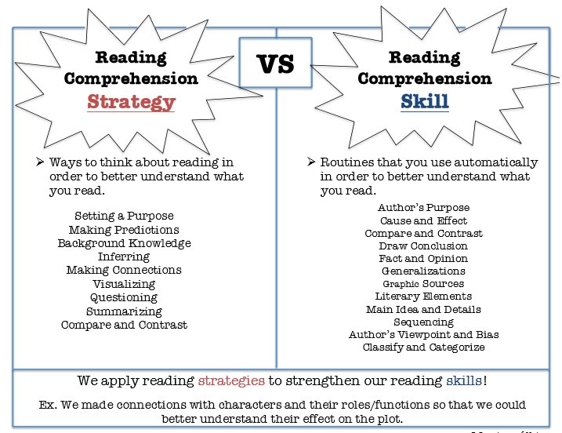

Slide 6
Online Resources
Students will be receiving a login for these sites. More information will be coming home on how we will be using these online resources to support our students learning.

Slide 7
Writer’s Workshop
Writing: Maisa Units
Personal narrative
Informational/Explanatory Essay: Cause and Effect
Persuasive (Argument) letter
Literary Essay
Word Study: Word Generation Vocabulary, Word Structure, and Grammar.
Writing Mini-lessons
On Demand Writing
Independent Writing
Conferring
Sharing

Slide 8
6th Grade ELA Assessments
DRA - Reading
Reading Fluency and Comprehension
Gives Grade Level Equivalent
Fall and Spring (as needed)
District Writing
Fall and Spring
Basic Score with Rubric
NWEA – Reading and Language
Fall and Spring
Measures academic growth
Give a Lexile (Reading Level)
Challenges students
Goal Orientated

Slide 9
Grading Scale
The District Grading Policy will be used to grade all assignments, projects and tests.
75% - Tests, Quizzes, Papers and Projects
25% - Daily Work (Classwork and Homework)
District Grade Scale:
A+ 100-98 C 76-73
A 97-93 C- 72-70
A- 92-90 D+ 69-67
B+ 89-87 D 66-63
B 86-83 D- 62-60
B- 82-80 E 59-50
C+ 79-77 F 49-0

Slide 10
Mrs. Cindy Hawkins Room 305 email: chawkins@wcskids.net Phone: (586) 825-2560 ext. 26305
Stay connected with
REMIND
Text this number:
81010
Text this message:
@c9kh62
Find this class:
Hawkinsela
Websites:
Grissom: www.wcskids.net/Grissom
Class website: mrschawkins.weebly.com

